Slide 1
Project Risk Management

Slide 2
PROJECT RISK MANAGEMENT
Project Risk Management includes the processes of conducting risk management planning, identification, analysis, response planning, response implementation, and monitoring risk on a project.
A risk is an uncertain event or condition that can have affect the outcome of a project.
The objectives of project risk management are to
Increase the probability and/or impact of positive risks (opportunities).
Decrease the probability and/or impact of negative risks(Threats), in order to optimize the chances of project success.

Slide 3
PROJECT RISK MANAGEMENT
Positive risks (opportunities)
Positive risks are events that, if they occur, will have a beneficial impact on the project. They can create opportunities to enhance project outcomes, save costs, or deliver additional value.
Example: A software development team discovers a tool that automates coding, reducing development time by 20%. Implementing a new technology unexpectedly enhances product performance or functionality.
Negative risks(Threats)
Negative risks are events that can have adverse effects on the project, such as delays, cost overruns, or quality issues. These need to be identified and mitigated to minimize their impact.
Unexpected costs arise due to market price fluctuations.
Example: The price of raw materials increases by 15%, leading to budget overruns.

Slide 4
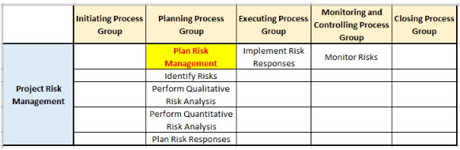
The Project Risk Management processes are:

Slide 5
What is Risk Management Process?
It is a series of steps that help the software team to understand and manage uncertainty. It involves
Identifying risks.
Assessing the probability of risks’ occurrence.
Estimating risks’ impact.
Ranking risks by probability and impact.
Establishing a contingency plan to manage risks if they occur.

Slide 6
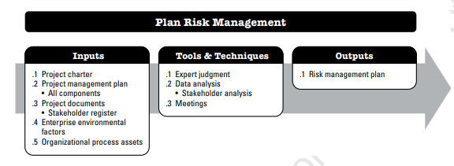
1: PLAN RISK MANAGEMENT
Plan Risk Management is the process of defining how to conduct risk management activities for a project.

Slide 7
1: PLAN RISK MANAGEMENT
Output: Risk Management Plan
- Component of project management plan
- It describes how risk management activities will be structured and performed.
The risk management plan may include the following elements.
Risk Strategy: Approach to manage risks.
Roles and responsibilities: Defines the lead, support, and risk management team members for each type of activity described in the risk management plan, and clarifies their responsibilities.

Slide 8
Risk Management Plan
Timing. Defines when and how often the Project Risk Management processes will be performed throughout the project life cycle.
Risk categories: Group individual project risks – A common way to structure risk categories is RBS(Risk Breakdown Structure) – a hierarchical representation of potential sources of risk.
The risk breakdown structure organizes the project’s risks into different categories e.g. technical, external, organizational, and project management.
Definitions of risk probability and impacts/Probability and impact matrix. Probability and impact matrix
Reporting Formats and Tracking: Reporting formats define how the outcomes of the Project Risk Management process will be documented, analyzed, and communicated./ Tracking documents how risk activities will be recorded and how risk management processes will be audited

Slide 9
Risk Categories
Technical Risks
Technical risks in a project refer to the potential problems that arise from new technology, system complexity, technical failures.. e.g. A software project faces integration issues due to compatibility problems between old and new systems.
External Risks
External risks are those that exist outside of the project’s organization. Such as political, governmental, climate, or economic changes.e.g. New government regulations increase costs or require a project redesign.
Organizational Risks: Organizational risks stem from internal challenges within the organization, such as resource constraints, unclear communication, or misaligned priorities. e.g. Poor communication between departments results in missed deadlines.
Project Management Risks
These risks arise from flaws in planning, execution, monitoring, or controlling the project. They often result from poor decision making. e.g. Budget overruns occur due to poor cost estimation.

Slide 10
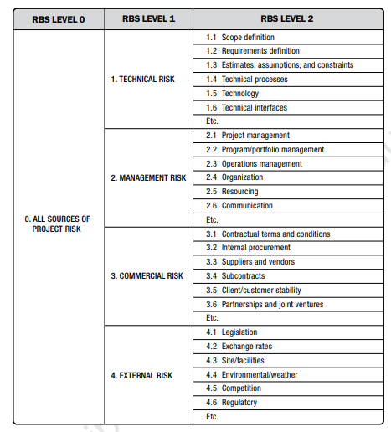
Risk Breakdown Structure

Slide 11
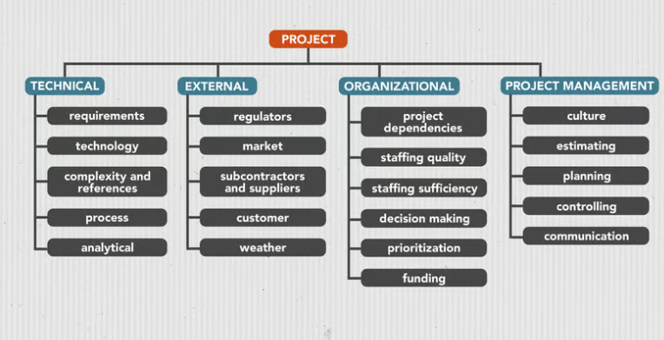
Risk Breakdown Structure

Slide 12
What is a project risk matrix?
A project risk matrix, also known as a Probability and Severity risk matrix, is a graphical risk analysis tool in the form of a table (matrix).
Allocate ratings for each risk based on two intersecting factors:
The likelihood (or probability) of a risk to occur.
The impact (or severity) if a risk occurs.
The higher a risk ranks for these two factors, the bigger threat it poses to your project.

Slide 13
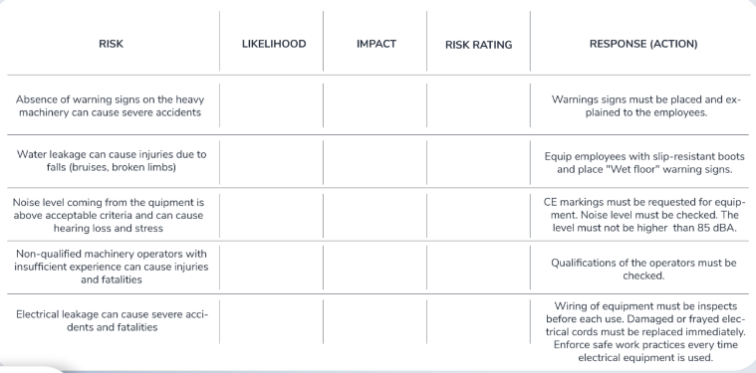
Risk matrix template: create a risk matrix for your project
Step 1. Identify project risks

Slide 14
Step 2: Determine the risk likelihood
In this step, you need to identify the likelihood of a given risk happening.
1 – (Very unlikely): A very slim chance for this risk to occur.
2 – (Not likely): Low chances for this risk to occur.
3 – (Possible): Fifty-fifty chances for this risk to occur.
4 – (Probable): Good chances for this risk to occur.
5 – (Very likely): You can bet this risk will occur at some point.

Slide 15
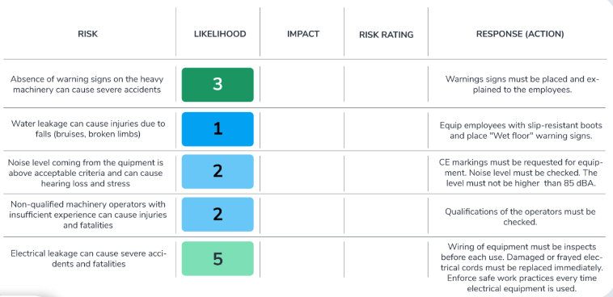

Slide 16
Step 3. Define the impact scale
1 – (Negligible): This risk will hardly impact your project.
2 – (Low): You can easily handle the consequences of this risk.
3 – (Moderate): It will take some time and effort to mitigate the consequences of this risk.
4 – (Significant): This risk could cause long-term consequences that will be hard to recover from.
5 – (Catastrophic): The impact of this risk might wreck your project.

Slide 17
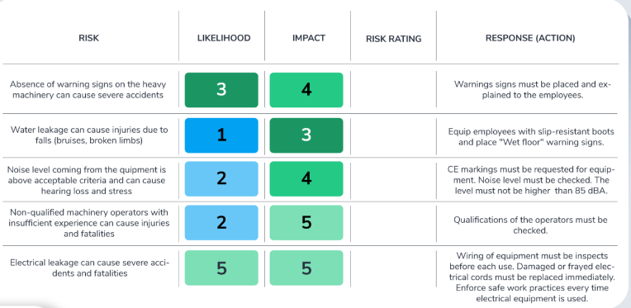

Slide 18
Step 4. Calculate the risk rating
The formula for the risk rating is as follows:
Likelihood x impact = Risk rating
e.g., Likelihood (4) x Impact (5) = Risk rating (20)
(A risk with such a high rating could threaten your project, therefore you should monitor it closely.)

Slide 19
The risk rating values will range from 1 to 25.
1 – 6 (Low): Low-rating risks most likely will not happen. If they do, they will not be a threat to your project.
7 – 12 (Medium): Some medium-rating risks might happen at some point. You do not need to prioritize them but you should not ignore them either.
13 – 25 (High): High-rating risks are serious and very likely to happen threats. They can cause your project to go off the rails, so you should keep them in mind when planning your project.

Slide 20
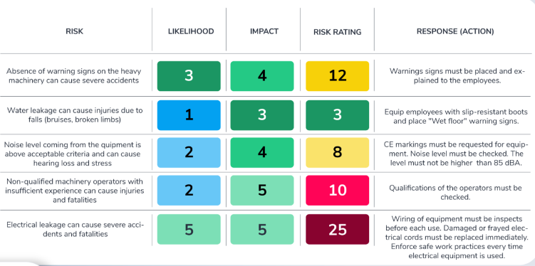
Project risk matrix

Slide 21
Case study:Development of a Cloud-Based Education Platform
A tech company is contracted to build a cloud-based education platform aimed at universities and schools. The platform will provide features like live classes, digital content management, and performance analytics for students and teachers. The project is high-priority, with a tight deadline of six months to launch before the upcoming academic year.
The platform needs to integrate seamlessly with existing legacy systems used by schools and universities. Government regulations mandate strict data security and compliance with privacy laws. The team comprises developers, testers, and project managers, with key members handling critical components like live streaming and analytics. The project budget is constrained, and timelines are tight due to contractual obligations.
Progress and Challenges:
1. Legacy System Integration
During initial development, the team discovered that integrating the platform with the diverse legacy systems used by different schools would be more complex than anticipated. This integration challenge risks delaying delivery timelines.
2. Regulatory Compliance
Midway through the project, a government directive introduced new data security standards for education platforms. These changes require the team to implement additional security features, which could increase development time and costs.

Slide 22
Case study:Development of a Cloud-Based Education Platform
3. Team Member Resignation
Two months into the project, a senior developer who was leading the live streaming module resigned. This resignation created a gap in expertise, slowing progress on a critical feature.
4. Underestimated Effort
Initial estimates for the live class and analytics features turned out to be overly optimistic. The team realized that building and testing these features required far more time than planned, leading to concerns about meeting deadlines.
Q1: Identify the project risks
Q2: Create Risk Breakdown Structure
Q3: Assessing the probability of risks’ occurrence, Estimating risks’ impact, Ranking risks by probability and impact, Establishing a plan to manage risks if they occur.

